Slide 1
GST in india
SUPPLY & VALUATION - by r.renugan

Slide 2

components…
GST in INDIA
TAXABLE EVENT
PERSON LIABLE TO TAX
RATE OF TAX
VALUE ON WHICH TAX IS PAYABLE
TIME OF SUPPLY
PLACE OF SUPPLY

Slide 3
TODAY…
GST IN INDIA
DUTY / TAX | TAXABLE EVENT
CUSTOMS | IMPORT / EXPORT
CENTRAL EXCISE | MANUFACTURE
SERVICE TAX | PROVISION OF SERVICE
VAT | INTRA- STATE SALE
CST | INTER - STATE SALE
ENTRY TAX | ENTRY OF GOODS

Slide 4
UNDER GST…
GST IN INDIA
ON SUPPLY OF GOODS ( EXCEPT LIQUOR)
SINGLE TAXABLE EVENT
TAX ON “SUPPLY” -
NOT DEFINED IN CONSTITUTION
MEANING & SCOPE - SEC 3 OF Model GST Law

Slide 5
SCOPE of “supply”…
supply…
Section 3(1) - Supply includes
(a) All forms of supply of goods and/or services such as sale, transfer, barter, exchange, license, rental, lease or disposal made or agreed to be made for a consideration by a person in the course or furtherance of business,
(b) Importation of services, for a consideration whether or not in the course or furtherance of business
(c) a supply specified in Schedule I, made or agreed to be made without a consideration.

Slide 6
Matters to be treated as “Supply” even without consideration
scope of supply…
Schedule I
1. Permanent transfer/disposal of business assets where input tax credit has been availed on such assets
2. Supply of goods or services between related persons or another establishment of the same legal entity which is required to take separate registration in the same state or another state
3. Supply of goods—
by a principal to his agent where the agent undertakes to supply such goods on behalf of the principal, or
by an agent to his principal where the agent undertakes to receive such goods on behalf of the principal
4. Importation of services by a taxable person from a related person or from any of his other establishments outside India, in the course or furtherance of business.

Slide 7
schedule - II,III & iv
scope of supply…
Schedule II - Determination of supply of goods or services
Section 3(3) - Neither goods nor services
(a) activities or transactions specified in Schedule III
(b) activities or transactions undertaken by Government specified in Schedule IV
Section 3(4) - Empowers the Government to notify any transaction as
(a) either goods or services
(b) neither goods nor services
Section 3(5) – Tax liability of “ Composite Supply and Mixed Supply”

Slide 8
stock transfers…
scope of supply…
GST is levied on supply of goods or services
Normally, supply pre-supposes existence of two distinct persons- Supplier and Recipient
In the case of stock transfer, supply is between the same entity and hence not taxable
Exception - Schedule I of CGST/SGST Act
Supply of goods or services between distinct persons as specified in Section 10
Supply of goods by a principal to an agent
Supply of goods by an agent to his principal
Importation of goods or services

Slide 9
time of “supply”…
supply …
The liability to pay GST arise only when supply is made
The time of supply fixes the point when the liability has to be discharged
The time of supply differs for supply of goods and supply of service
Section 12 and 13 of Model GST Law prescribes time of supply for goods and services respectively

Slide 10
goods…
time of supply …
Time of supply - General principles for goods
Removal of goods
Issue of invoice
Receipt of payment
Time of supply - For specific goods
Continuous supply of goods
Supply of vouchers
Reverse charge
Residual provision

Slide 11
services…
time of supply …
Time of supply - General principles for services
Issue of invoice
Receipt of payment
Time of supply - For specific services
Continuous supply of service
Supply of vouchers
Reverse charge
Residual provision

Slide 12
before rate change…
supply…
SITUATION | TIME OF SUPPLY
INVOICE ISSUED & PAYMENT RECD AFTER RATE CHANGE | EARLIEST OF DATE OF PAYMENT OR DATE OF INVOICE
INVOICE ISSUED BEFORE & PAYMENT RECD AFTER RATE CHANGE | DATE OF INVOICE
PAYMENT RECD BEFORE & INVOICE ISSUED AFTER RATE CHANGE | DATE OF PAYMENT

Slide 13
AFTER rate change…
supply…
SITUATION | TIME OF SUPPLY
INVOICE ISSUED & PAYMENT RECD PRIOR TO RATE CHANGE | EARLIEST OF DATE OF PAYMENT OR DATE OF INVOICE
INVOICE ISSUED AFTER & PAYMENT RECD PRIOR TO RATE CHANGE | DATE OF INVOICE
PAYMENT RECD AFTER & INVOICE ISSUED PRIOR TO RATE CHANGE | DATE OF PAYMENT

Slide 14
PRINCIPLES…
VALUATION…
Determination of value is not only required to determine the GST payable but also to compute the turnover for threshold limit or Composition Scheme
GST Law proposes to adopt the concept of transaction value for determining the taxable value of supply or service

Slide 15
VALUATION…
GST IN INDIA
As per section 15 of Revised Model GST law, the taxable value is the price actually paid or payable for supply of goods or services
The taxable value shall include:
Any amount that the supplier is liable to pay but incurred by the recipient and not included in the price
Incidental expenses such as commission, packing , etc, charged by the supplier
Any taxes, duties, cesses, fees and charges levied under any statute charged by the supplier other than the GST
Interest or penalty or late fee for delayed payment
Subsidies, except the subsidy provided by the Government

Slide 16
VALUATION…
GST IN INDIA
The taxable value shall not include “discounts” given before or at the time of supply, if such “discount” is shown in the invoice
“Post supply discount” also not includible,
If it is established in terms of an agreement and known before or at the time of supply and
ITC has been reversed by the recipient

Slide 17
VALUATION…
GST IN INDIA
If the value could not be arrived at as per Section 15(1), then the same will be determined as per the provisions of Valuation Rules
Since the draft Valuation Rules released along with the earlier Model Act has not been revised, it is presumed that it still holds good
Non monetary consideration
Related party transactions
Comparable method
Computation method
Pure agent

Slide 18
place of “supply”…
supply …
The need for ascertaining Place of Supply (POS)
The dual tax in a federal setup demands exact determination of POS
In the case of intra-state supply, Centre and States are empowered to levy CGST and SGST respectively
In the case of inter-state supply, the Centre is empowered to levy IGST
The import and export of goods and services are deemed to be considered as inter state supply
Therefore, determination of place of destination is vital

Slide 19
place of “supply”…
supply …
Goods, being tangible in nature, do not pose significant problems for determining the place of destination
The only challenge in the case of goods is e-commerce based trading of goods and supply to third parties
However, in the case of services, it is difficult to determine the place where the services are acquired, enjoyed and consumed

Slide 20
place of “supply”…
supply …
The determination of POS becomes more complex in certain category of services
Sale of pre paid cards - location of service receiver
Broadcasting service or roaming telecom service - The place where the service is consumed
Construction of Railway line, National high way or Bridge which originate in one State and end in the other State
The card issued by Delhi Metro could be used by a person located in Delhi or Noida or Faridabad
Catering service provided on board
Separate POS for goods and services

Slide 21
goods…
place of supply …
When goods are moved - Location of goods at the time at which the movement terminates for delivery to the recipient
If the goods are delivered to a recipient on the direction of a third party – Principal place of supply of third party
Without involving movement of goods – Location of goods at the time of delivery to the recipient
Assembly of goods at site – Place of installation
Supplied on Board a conveyance – The location at which the goods are taken on board
Import of goods – location of importer
For export of goods – Location outside India

Slide 22
services…
place of supply …
Supplier and recipient of services located in India
General Rule -
Provided to registered person – location of recipient
Unregistered person - If address exist – Location of recipient
If address not available- Location of supplier of service
For specific services-
Services relating to immovable property, Accommodation by hotel, guest house, boat house, etc, Mandap or convention service – Location of immovable property
Restaurant & catering service, Beauty treatment, Health & fitness service, Health services – The place of performance
Training and performance appraisal –
Location of registered person
Place of performance in case of unregistered person

Slide 23
services…
place of supply …
Admission to cultural, entertainment event, etc or amusement park – Place of performance or location of amusement park
Event management or Exhibition service –
Location of registered person
Place of performance in case of unregistered person
Transportation of goods, Courier-
Location of registered person
In other cases-Place of handing over of the goods for transportation
Passenger Transportation -
Location of registered person
In other cases-Place of embarkation
Services on board a conveyance such as aircraft, train, vessel, etc – Location of the first scheduled point of departure

Slide 24
services…
place of supply …
Telecommunication service, broadcasting service, DTH service-
Services provided through fixed lines – Location of such fixed lines
Mobile connection on post paid basis – location of billing address
Pre payment basis - (a) Location of selling agent (b) In other cases of pre payment – Location where pre payment is made
In other cases – Address of the recipient
If address not available – Location of provider of service
Banking and financial service, stock broking service-
Location of recipient of service
If address not available- Location of service provider
Insurance service-
Location of registered person
In other cases, location of recipient of service
Advertisement service to Central or State Government or Local authority – Location of each state where the services are disseminated

Slide 25
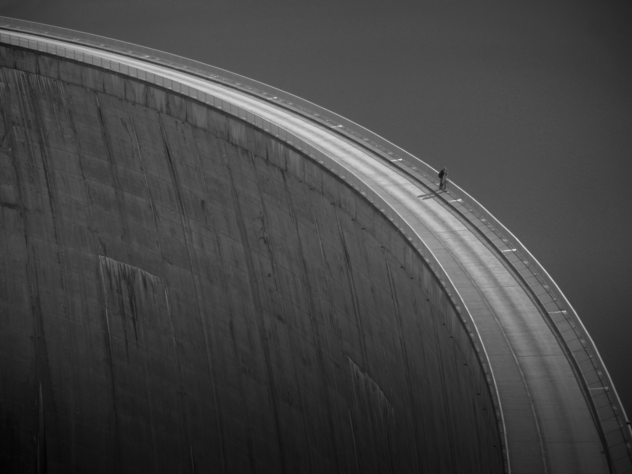
chennai . coimbatore . madurai . bengaluru . hyderabad . pune . ahmedabad. nagpur . delhi
www.swamyassociates.com

